Slide 1
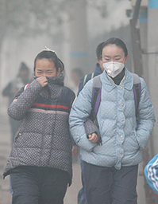
Writing 39C: Argument and Research Theme: Healthcare and Medicine Fall 2016 and Winter 2017
Anita W. Fischer
Enrollments: 57 (Fall 2016) and 46 (Winter 2017)
Integration Of Climate/Sustainability Content:
Students brainstorm and research problems within our theme for a quarter-long project:
➢ 1st Essay: Use academic research to identify, define, and prove the problem exists.
➢ 2nd Essay: Identify and convincingly advocate for solution ideas (policies, proposals, recommendations) to help solve the problem.
Image from student paper on the health effects of air pollution in Chinese cities.
Notes:
This is a 2-minute presentation I had prepared for the Sustainability Initiative networking event on November 4, 2016, to the group from UCI with whom I had attended the Teaching Climate Change Workshop in April 2016.
Slide 1:
In my Writing 39C classes (required of all UCI undergraduates), students write two research-based argumentative essays, one about a problem and the second advocating for solution(s) to the problem .
Our theme was healthcare and medicine using as our theme text Atul Gawande’s Better: A Surgeon’s Notes on Performance, so I wanted to model a way for them to find environmental based topics within this theme.

Slide 2
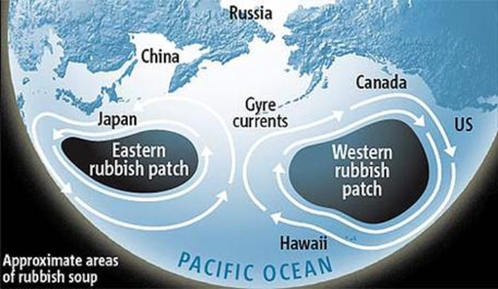
Writing 39C: Argument and Research Theme: Healthcare and Medicine Fall 2016 and Winter 2017
Anita W. Fischer
Model how to generate a problem statement that considers sustainability within our theme, driven by available research.
My model example: Environment & Healthcare → Biohazard waste? → Recycling medical materials → Needle disposal! → Drug users → Homeless drug users → “The problem of needle disposal by homeless drug users in Los Angeles.”
Student topic examples from Fall 2016:
➢ Health effects of air pollution in Chinese cities.
➢ Health effects of plastic waste accumulation in oceans.
Image from student paper on the health effects of plastic waste accumulation in our oceans.
Notes:
Slide 2:
I modeled how to brainstorm topics related to environmental sustainability while staying within our theme of healthcare, using available research, first from Google and then moving into academic articles using our library’s article databases.
Starting with Google News searches, as they would, I began generally with “environment and healthcare” and, based on results, soon narrowed the topic to “biohazard waste” and then soon started seeing numerous articles about “needle disposal” affecting the environment and within that to drug users and specifically homeless drug users who had no place to dispose of their needles, hence contributing to the negative environmental impact.
A couple of students picked up the environment focus mantle and wrote papers on such issues as the health effects of air pollution in Chinese cities and the health effects of plastic waste accumulation in oceans.
I’ll be formalizing this process and offering specific topics and research when I teach this course again in Winter quarter 2017.

